Slide 1

University of Central Florida CGS 2545 Database Concepts

Slide 2
Three Schema Architecture

Slide 3
Three Schema Architecture
The three schema architecture is also called ANSI/SPARC architecture or three-level architecture
This framework is used to describe the structure of a specific database system
The three schema architecture is used to separate the user applications and physical database
The three schema architecture contains three-levels
It breaks the database down into three different categories

Slide 4
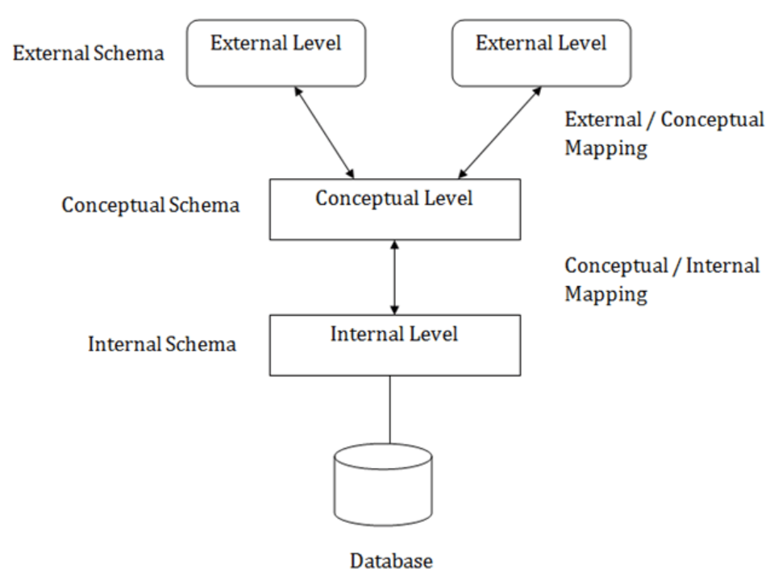
Three Schema Architecture

Slide 5
Three Schema Architecture
In the diagram
Mapping is used to transform the request and response between various database levels of architecture
Mapping is not good for small DBMS because it takes more time
In External / Conceptual mapping, it is necessary to transform the request from external level to conceptual schema
In Conceptual / Internal mapping, DBMS transform the request from the conceptual to internal level

Slide 6
Three Schema Architecture
Internal Level
The internal level has an internal schema which describes the physical storage structure of the database
The internal schema is also known as a physical schema
It uses the physical data model
It is used to define that how the data will be stored in a block
The physical level is used to describe complex low-level data structures in detail

Slide 7
Three Schema Architecture
Conceptual Level
The conceptual schema describes the design of a database at the conceptual level
Conceptual level is also known as logical level
The conceptual schema describes the structure of the whole database
The conceptual level describes what data are to be stored in the database and also describes what relationship exists among those data
In the conceptual level, internal details such as an implementation of the data structure are hidden
Programmers and database administrators work at this level

Slide 8
Three Schema Architecture
External Level
At the external level, a database contains several schemas that sometimes called as subschema
The subschema is used to describe the different view of the database
An external schema is also known as view schema
Each view schema describes the database part that a particular user group is interested and hides the remaining database from that user group
The view schema describes the end user interaction with database systems

